Slide 1
Colourization of Grayscale Images
Sandy Dai - 1003277973
Abhishek Paul - 1002395188
Yang Xiu - 1002654950
Group 14
Notes:
Citations needed
10s

Slide 2
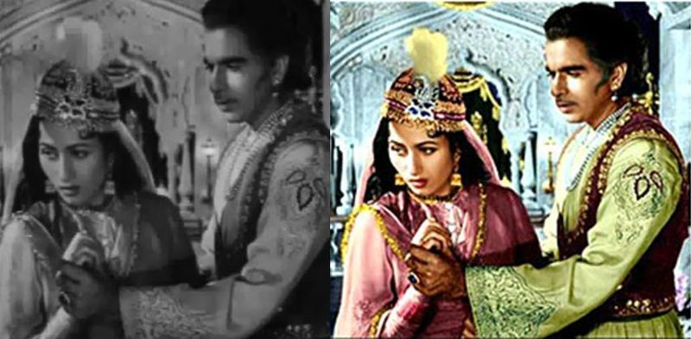
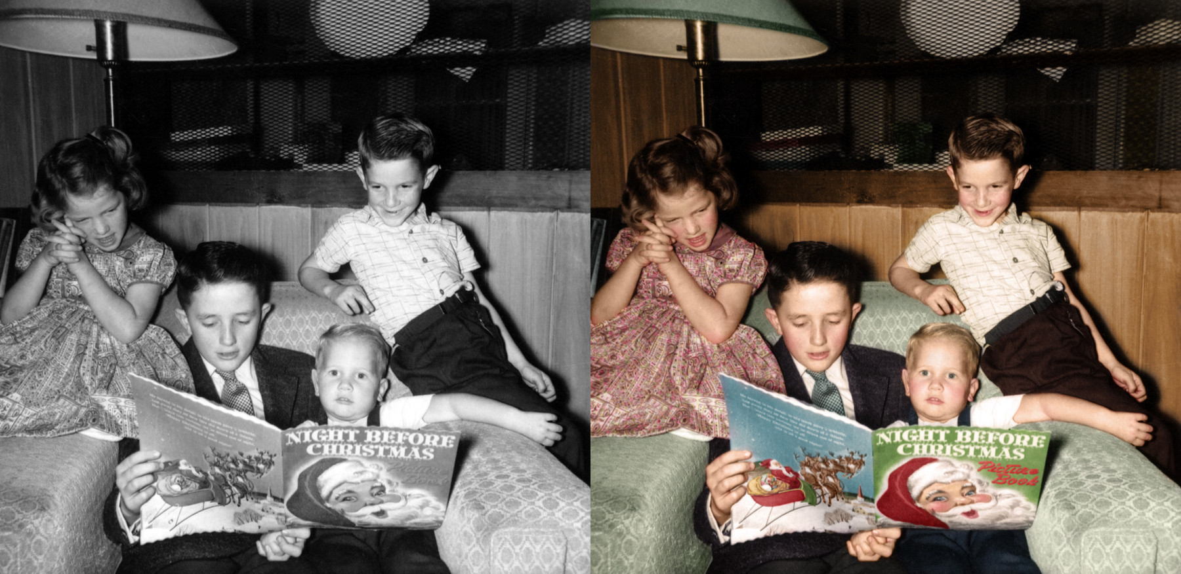
Background & Context
Photographs connect us to the past, tell stories, and share rare sightings
The importance of colour: information, contrast, detail
Traditional colourization done on Photoshop taking up to a month
Google Image Result for https://i.stack.imgur.com/NXbZk.jpg. [Online]. Available: https://images.app.goo.gl/Ueuswt3QNuE6G6128.
Google Image Result for https://i.imgur.com/YGykcu5.jpg. [Online]. Available: https://images.app.goo.gl/H3feYoMFe2LFHrXd8.
Notes:
https://images.app.goo.gl/Ueuswt3QNuE6G6128
https://images.app.goo.gl/H3feYoMFe2LFHrXd8
1:03

Slide 3
Our Goal
Realistically colourize gray-scale images
Note: Doesn’t have to be an exact match of the what the real life colours are - it just has to look plausible
Model approach: Develop a Generative Adversarial Network (GAN) to generate new coloured images
Notes:
25
1min

Slide 4
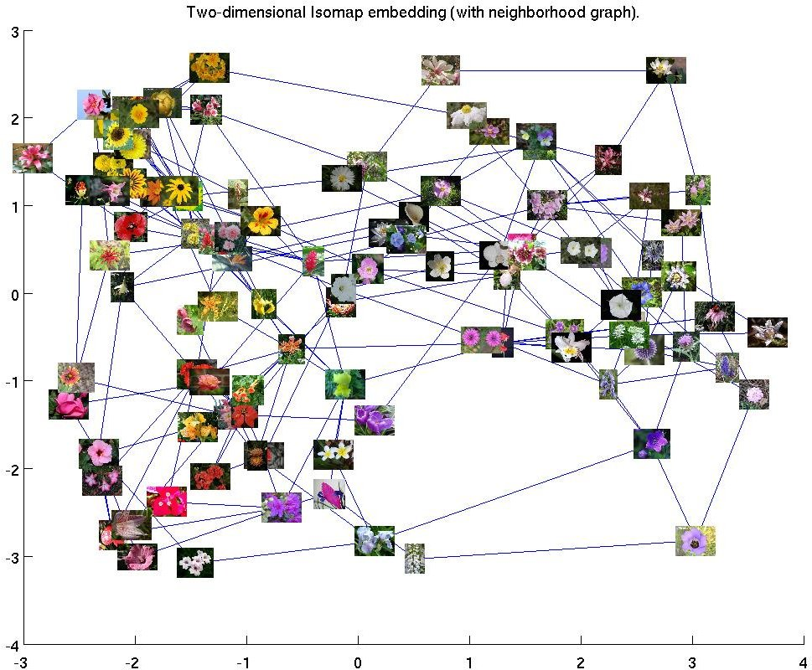
Data
Colour Isomap
Flower Dataset University of Oxford
8189 images from 102 different flowers
Test set contains 210 flowers
Initially tried random images but then settled upon a Category
Generalizes well to different colors
Does not generalize to different types of images
M.-E. Nilsback and A. Zisserman, “Flower Datasets,” Visual Geometry Group - University of Oxford. [Online]. Available: https://www.robots.ox.ac.uk/~vgg/data/flowers/. [Accessed: 26-Nov-2019].
Notes:
1:50
citation
1min

Slide 5
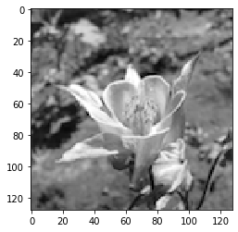
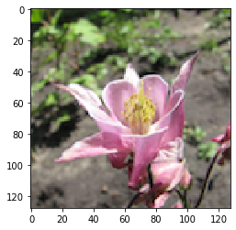
Data Processing
Input
Resize images to 128x128
Convert to grayscale
Linux commands
Imagefolder
Shuffle Data
Convert to dataloader
Label
Notes:
37

Slide 6
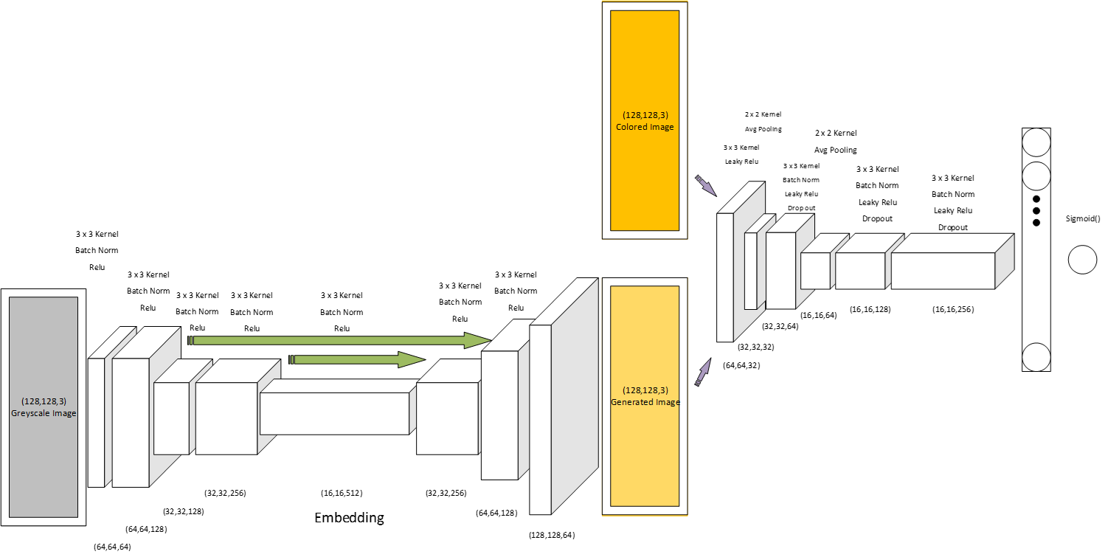
Current: Generative Adversarial Model
Autoencoder Generator
Discriminator
Notes:
1:51
1.:30 min

Slide 7
3-Pronged Approach to Hyperparameters
Model Architecture
Increased layers
Non-linearity (Sigmoid vs TanH vs LeakyReLU vs ReLU)
Skip-connections
Regularization of Discriminator
Conditional training
Feed noise for GAN stabilization
Drop-out layers
Varying learning rate
Loss function
BCELoss + L1 loss
Notes:
1:06 *

Slide 8
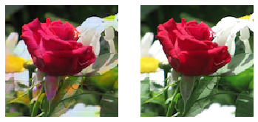
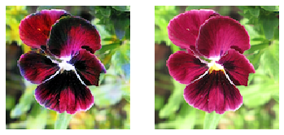
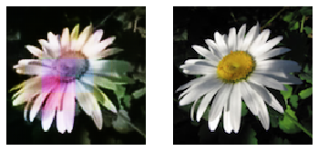
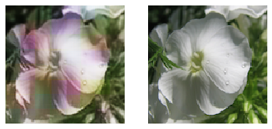
Training and Testing Results
Training Samples
Test Samples
Notes:
1:05
30

Slide 9
Demonstration
Notes:
1:41
1min

Slide 10
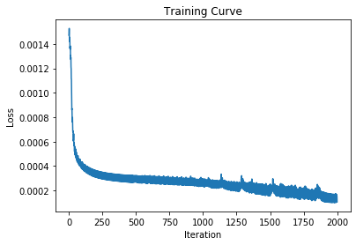
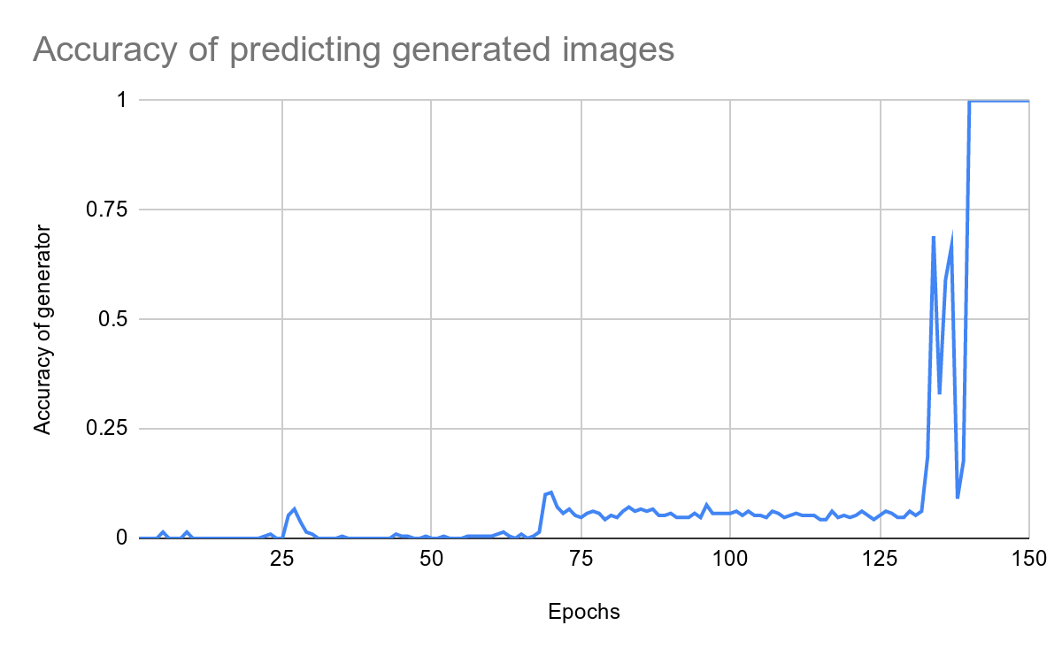
Quantitative Results
Notes:
Accuracy of discriminator
1:34
1:30
210 Testing images - smaller flower dataset
Random images
Evaluate qualitatively
Quantitative through loss and eval
210 Testing images - smaller flower dataset
Random images
Evaluate qualitatively
Quantitative through loss and eval function

Slide 11
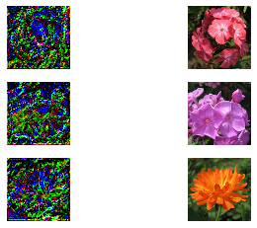
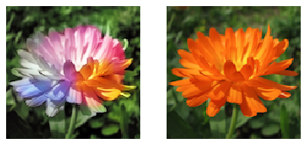
Model Iterations and GANs
Autoencoder with skip connections (concat)
Blurry
Inaccurate colours
Square colour blocks in images
UNet
Much deeper CNN autoencoder
Perfect edge detection but poor colourization
Notes:
1:07
45

Slide 12
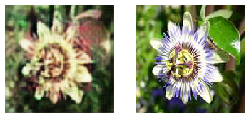
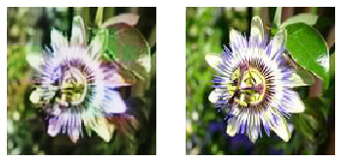
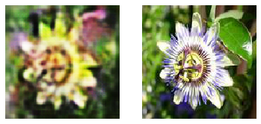
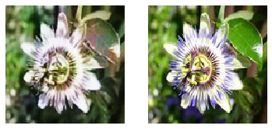
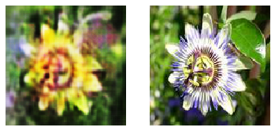
Results of Iterations
5-layer Autoencoder
9-layer Autoencoder
w/ skip connection
7-layer Autoencoder
9-layer GAN
w/ skip connection
autoencoder generator
7-layer Autoencoder
w/ Leaky_ReLU
Notes:
30

Slide 13
Discussion on Improvements
Stacking models with UNet Embedding Detections
More tuning parameters w GAN:
HighwayNet or DenseNet (different types of skip-connections)
Adding noise to RGB and grayscale
Notes:
21

Slide 14
Thank you for listening!

